Slide 1
Application of Recurssion and Backtracking
Group No 14
Shyam Kawale [29]
Bhargav Pawar [50]
Nishant Bhat [43]
Abhijit Gawai [18]
Guide – R.S Jadhav

Slide 2
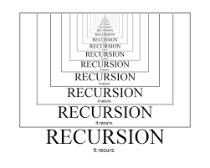
RECURSSION

Slide 3
WHAT EXACTLY IS RECURSSION?
Recursion is the process of repeating items in a self-similar way.
In programming languages, if a program allows you to call a function inside the same function, then it is called a recursive call of the function.
The power of recursion evidently lies in the possibility of defining an infinite set of objects by a finite statement.
In the same manner, an infinite number of computations can be described by a finite recursive program, even if this program contains no explicit repetitions.

Slide 4
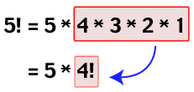
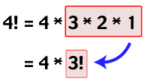
FACTORIAL EXAMPLE
The factorial function, often denoted as n!, describes the operation of multiplying a number by all the positive integers smaller than it.
n! = n*(n - 1)!

Slide 5
CRITERIAS OF WRITING A RECURSSIVE FUNCTION
Base Case
General Case
Diminishing the size of problem

Slide 6
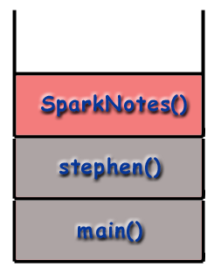
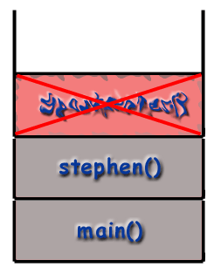
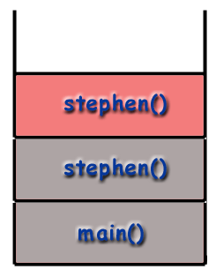
CALL STACK
When a function is called, a certain amount of memory is set aside for that function to use for purposes such as storing local variables.
This memory, called a frame, is also used by the computer to store information about the function such as the function's address in memory.
This allows the program to return to the proper place after a function call.
This is made possible by the frame

Slide 7
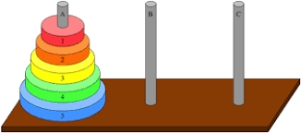
Applications of recursion
Factorial of number.
n! = n*(n-1)*(n-2)*(n-3)*....... Where n>=0.
Fibonacci Sequence.
1,1,2,3,5,8,13,21,.........
Fib(n) = Fib(n-1) +Fib(n-2). Where Fib(0)=1 & Fib(1)=1
Tower of Hanoi.

Slide 8
Other applications
Sorting Algorithm.
1) Quick Sort.
2) Merge Sort.
Tree traversal (inorder, preorder, postorder)
Depth First Search in Graph
NP problems
Backbone of AI
Puzzle Game.
1) Chess.
2) Candy Crush game

Slide 9
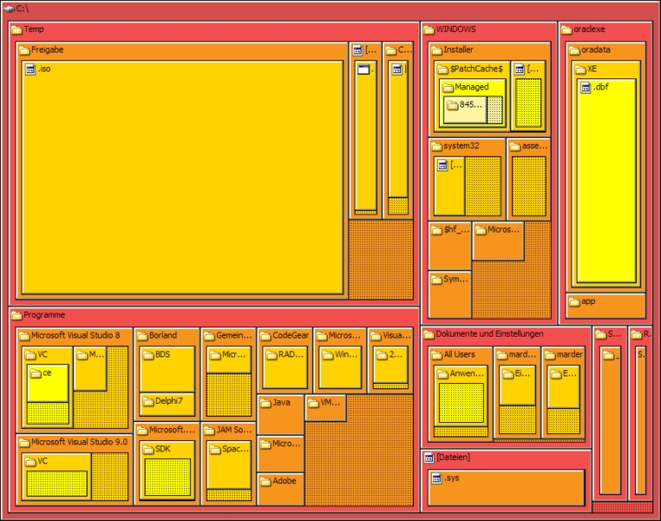
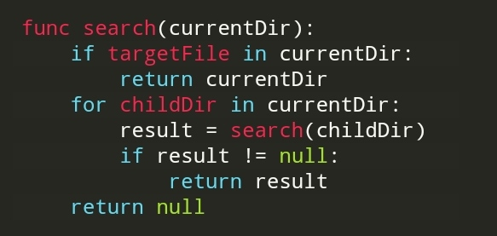
File Trees and Parsing (Search Indexing)
Recursive function
Finding a file in your machine without manually checking it

Slide 10
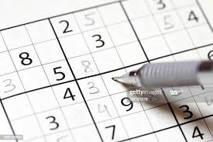
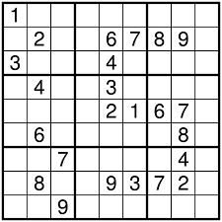
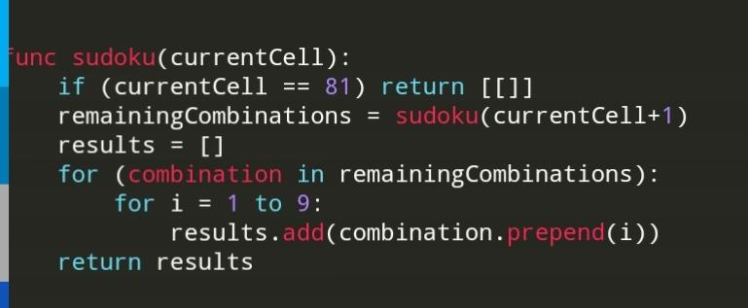
Sudoku Game
Recursive function
9*9 matrix. ➔ 81 cells of 1d array

Slide 11
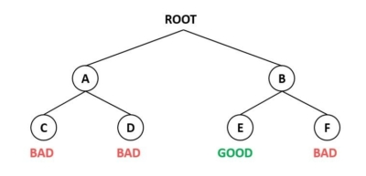
BACKTRACKING
Backtracking is an algorithm technique for solving problems recursively by trying to build a solution incrementally, one piece at a time, removing those solutions that fail to satisfy the constraints of the problem at ant point of time.
REFERENCE:-https://www.geeksforgeeks.org/backtracking-introduction/

Slide 12
PSEUDO CODE
The backtracking algorithm reduces the problem to the call bt(root(P)), where bt is the following recursive procedure: procedure bt© is if reject(P, c) then return if accept(P, c) then output(P, c) s ← first(P, c) while s ≠ NULL do bt(s) s ← next(P, s)

Slide 13
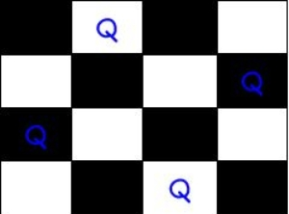
EXAMPLE OF BACKTRACKING
N-Queen Problem Algorithm 1) Start in the leftmost column 2) If all queens are placed return true 3) Try all rows in the current column. Do following for every tried row. A) If the queen can be placed safely in this row then mark this [row, column] as part of the solution and recursively check if placing queen here leads to a solution. B) If placing the queen in [row, column] leads to a solution then return true. C) If placing queen doesn’t lead to a solution then unmark this [row, column] (Backtrack) and go to step (a) to try other rows. 4) If all rows have been tried and nothing worked, return false to trigger backtracking.
REFERENCE:-https://www.tutorialspoint.com/introduction-to-backtracking

Slide 14
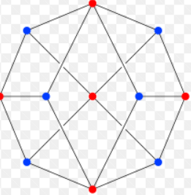
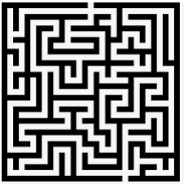
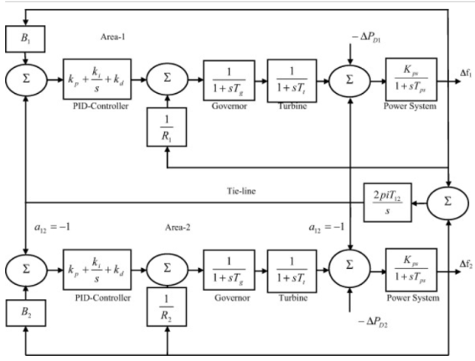
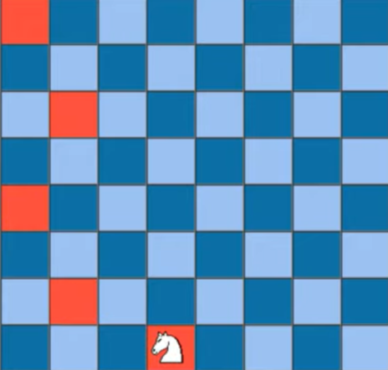
Application of Backtracking
To find all Hamiltonian Paths
Maze solving Problems
Load frequency control in power system
The Knight’s tour problem

Slide 15
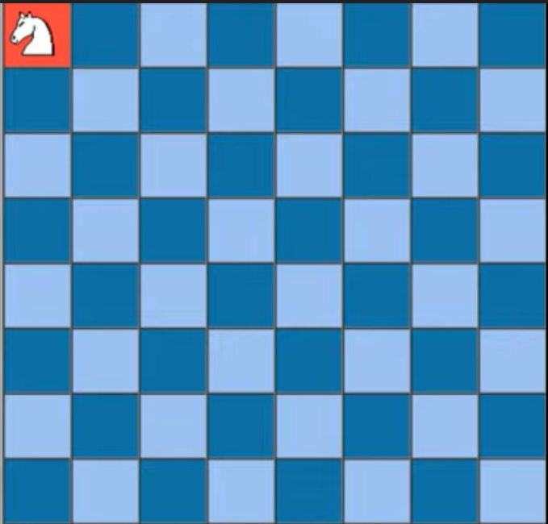
The Knight’s tour problem
Problem Statement:
Knight is placed on first block of chess board.
Move Knight to occupy whole board.
Print order in which cells are to be visited.
Constraints
Cannot visit already visited cell.
Cannot move out of chess board.

Slide 16

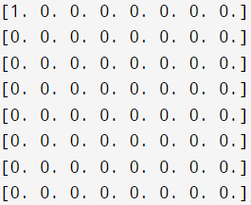
The Knight’s tour problem
1st visit to [0][0]

Slide 17
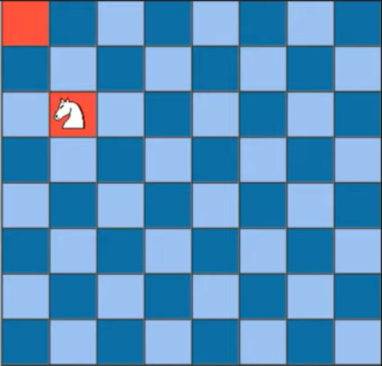
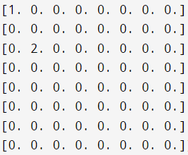
The Knight’s tour problem
1st visit to [0][0]
2nd visit to [2][1]

Slide 18
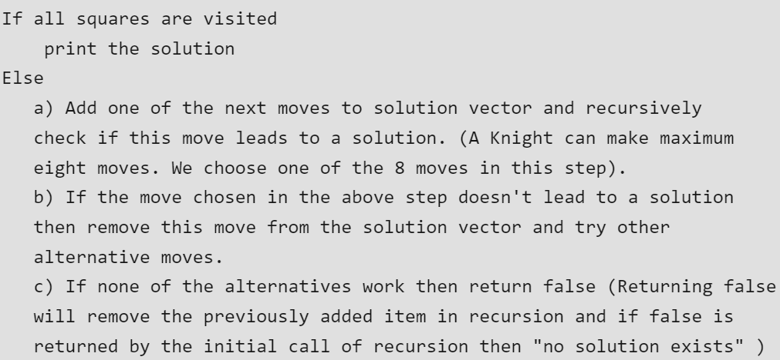
Pseudo Code of Knight’s tour problem

Slide 19
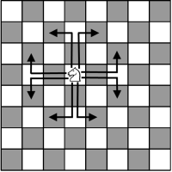
Code of Knight’s tour problem (Python)
def solveKT(n):
board = [[-1 for i in range(n)]for i in range(n)]
move_x = [2, 1, -1, -2, -2, -1, 1, 2]
move_y = [1, 2, 2, 1, -1, -2, -2, -1]
board[0][0] = 0
position = 1
# Checking if solution exists or not
if(not solveKTUtil(n, board, 0, 0, move_x, move_y, pos)):
print("Solution does not exist")
else:
printSolution(n, board)
solveKT(8)

Slide 20
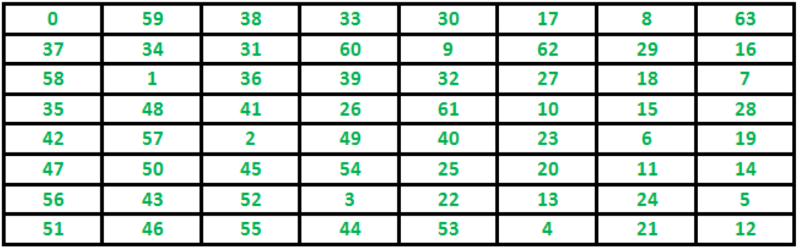
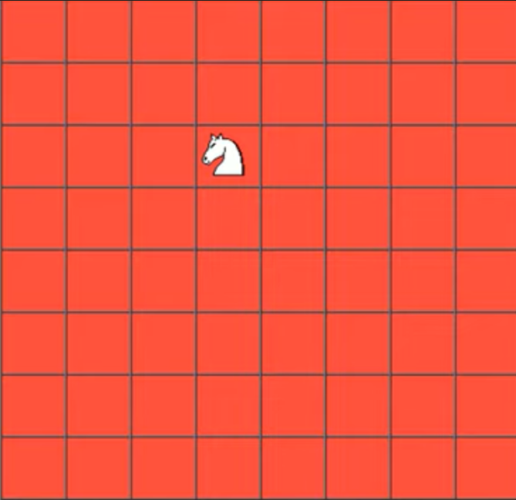
Solution of Knight’s tour problem
Final Output –
board[8][8] -
Reference - https://www.geeksforgeeks.org/the-knights-tour-problem-backtracking-1

Slide 21
References
[1] https://medium.com/@frankzou4000/recursion-and-its-applications-4dc00ee94130#:~:text=Practical%20Applications%3A,many%20software%20applications%20are%20built
[2] https://www.americanscientist.org/node/3595
[3] http://pages.cs.wisc.edu/~calvin/cs110/RECURSION.html
[4] https://www.byte-by-byte.com/understanding-recursion
[5] https://www.geeksforgeeks.org/backtracking-introduction
[6] https://www.sciencedirect.com/science/article/pii/S2090447916000125#bg005
[7] https://www.geeksforgeeks.org/the-knights-tour-problem-backtracking-1

Slide 22
THANK YOU

